Slide 1
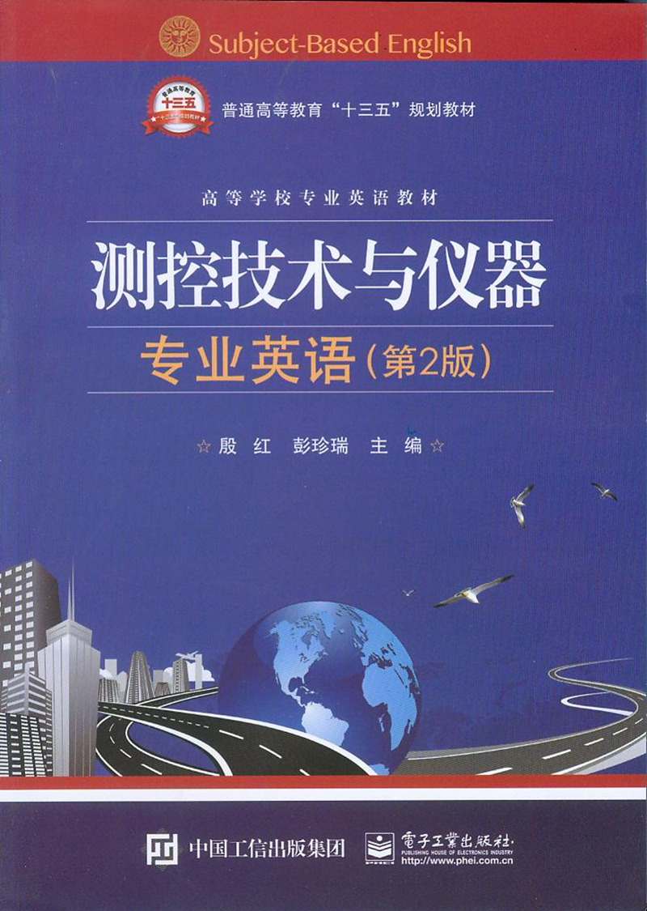
Unit11 Virtual Instrumentation

Slide 2
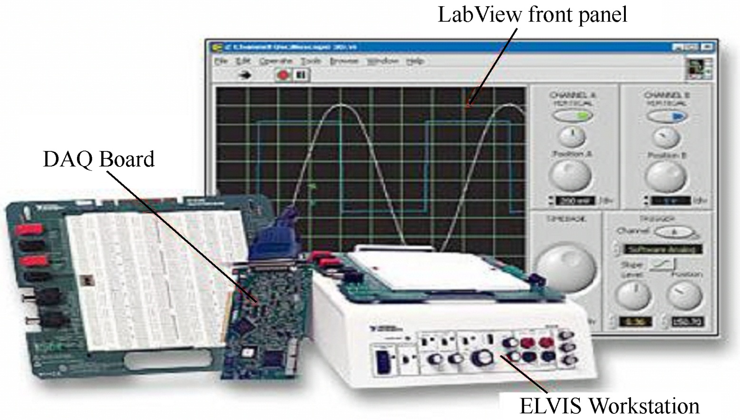
Unit11 Virtual Instrumentation

Slide 3
What is a “virtual instrument?” (虚拟仪器)What is a “virtual” anything? A virtual item is one that exists in function, but not in actual form. Does that mean that a virtual instrument really doesn’t exist? No. It exists, but not in the form that we are used to seeing. OK, so, what’s a virtual instrument?
什么是“虚拟仪器”？什么是“虚拟”事物？虚拟事物是其功能存在，而不存在实体的事物。这意味着虚拟仪器真的不存在实体吗？不，它存在，只是不像我们平时所看到的那种形式。好了，那么，什么是虚拟仪器呢？

Slide 4
Firstly, a little history. A few hundred years ago, we didn’t know much of anything electrical. Then came the work of Ohm, Oersted, Ampere, Watt, and a host of others. We defined such parameters as voltage, current, and power. And the new field of electricity was born.
首先，我们看一些历史发展。几百年前，我们不知道任何电子产品。随着欧姆、奥斯特、瓦特以及很多人工作的展开，我们定义了电压、电流和功率等参数，一个全新的电学领域诞生了。

Slide 5
The electronics age 电子时代
The electronics age began with vacuum tubes(电子管), radios, and then, television. During World War II, a plethora(过多、过剩) of electronics was developed for the military, changing the course of navigation(航行（学）、导航、领航), communications, and control from mechanical and visual to electrical and electronics. We developed instruments to measure the electrical parameters involved.
随着电子管，收音机，然后是电视的出现，电子时代到来了。在第二次世界大战期间，过剩的电子器件开发出来用于军事领域，将航海、通信的方向从机械和光学领域改变到电气和电子学领域。我们开发仪器用于测量相关的电参数。

Slide 6
There were some well-known companies associated with our recent history. The names of Simpson(美国辛普森仪表公司),Westin, Ferris, Fluke, RCA(美国无线电公司), DuMont, and, of course, Hewlett Packard (美国无线电公司)are firmly embedded in our instrumentation lore （学问和传统）.
在近代历史上有一些著名的公司。辛普森，威斯汀，菲利斯，福禄克，RCA（美国无线电公司），杜蒙特，当然还有惠普，这些名字深深地嵌入在我们的仪表学科中。

Slide 7
We must not forget others such as Tektronix(美国泰克公司), Keithley(美国吉时利仪器公司), General Radio(英国一家电子监测装备公司)(later GenRad), and General Electric(美国通用电气公司), although these are only a handful of the avalanche of instrmentation makers that represent our heritage. We grew up, even from our college days, surrounded by these company names.
我们也不会忘记其他一些名字，如泰克，吉时利，通用无线电（后来称为GenRad尖锐），还有通用电气，虽然这里只列出了很少的一些仪器制造商，但他们势如破竹，代表了我们仪器发展的里程。从大学时代起，我们的成长就伴随着这些公司的名字。

Slide 8
Division of labor 劳动力分工
There were concurrent developments in other fields. The biggest ones were in the computer field. Capacity increased while size decreased. But the two fields, instrumentation and computers, remained separate. Then, the microprocessor was developed, and computational size, cost, and power dissipation（损耗，耗散）plummeted （直落下，骤然跌落）, allowing pieces of computers to fit into other devices.
几个其他的学科领域在同时发展，最大的一个是计算机领域。计算机存储容量提高，而尺寸不断减小。但仪器和计算机两个领域一直保持独立发展。然而，随着微处理器的发展，计算机的尺寸、成本和能耗不断下降，允许将计算机芯片嵌入到其他设备中。

Slide 9
There were transducer linearizers, Fourier transformers, graphing and display drivers, and similar single- and limited-purpose devices.
这些设备有变送器线性电路，傅里叶变换器，绘图和显示装置，以及类似的单一用途设备和专用设备。

Slide 10
It became normal for a measuring instrument to accept a signal; condition the input by linearizing, shaping, band limiting, etc.; and then digitize the result. The digital output was manipulated in a special, on board processor in order to provide control or analytical decisions.
句中accept，condition和digitize三个并列成分的动词不定式作宾补。
译为：对一个测量仪器接收信号来讲，通过线性化、整形、频带限制等调理输入信号，然后对结果进行数字化处理，这些都变得非常平常。数字输出。在专业的单板处理器上进行处理，从而提供控制或分析决策。

Slide 11
The instrument generated the correction signal and transmitted this to the device under test to control the total function. All of this had to happen too fast for any but an onboard, special-purpose computer.
仪器产生校正信号，并将它送到测试设备中，来控制整体功能。所有这些都要仅在一个单板专用计算机内很快执行。

Slide 12
The speed and capability of general-purpose computers advanced exponentially. It soon became possible to adapt standard, high-speed computers to the online applications required in real time measurement and control. General-purpose computers（通用计算机） could become part of instruments.
通用计算机的速度和性能增长的越来越快。很快就有可能将标准高速计算机应用于实时测控在线应用场合。通用计算机可以成为仪器的组成部分。

Slide 13
Opening the Windows
It became the norm for instruments to be developed with embedded subsets of general-purpose computers, allowing diverse measurement and complex manipulations along with memory, look-up tables, and intelligent displays and controls.
仪器的开发需要嵌入通用计算机子系统，这成为了一个标准，要允许进行各种测量和复杂操作，同时还能存储、查询数据表、智能显示和控制。

Slide 14
With the addition of some specialized software, any laboratory bench（试验台）computer could be made capable of doing what, a short time ago, only the very special ones could accomplish.
再加上专用软件，在不久前，任何实验台计算机都能完成只有非常专业的计算机才能完成的任务。

Slide 15
Consider what a virtual instrument and control system might contain. For a measurement instrument, there must be a sensor. If the parameter being measured is not electrical, this must incorporate a transducer to change the information to an electrical signal. Then, there has to be a conditioning circuit（信号调理电路） to bring the signal to a level where it can be used.
考虑一下虚拟仪器和控制系统都包含什么。对一个测试仪器来讲，必须要有传感器。如果被测参数不是电量，必须要有变送器将信息转变成电信号。然后，就需要一个信号调理电路将信号调理到可用的大小。

Slide 16
This may include amplifiers, linearizers, filters, and even rectifiers （整流器）. Finally, there must be an analog-to-digital converter to allow the data to be transformed into digital format for further manipulation.
可能包括放大器，线性化电路，滤波器，甚至整流器。最后，必须有模数转换器允许数据转换成数字形式以便进一步处理。

Slide 17
Using any of the myriad formats from RS-232 to GPIB to USB to Ethernet to SCSI, the interface between the components can be balanced for speed.
句中RS-232是一种串行通信接口标准，GPIB通用接口总线（General-Purpose Interface Bus），USB通用串行总线架构（Universal Serial Bus），Ethernet以太网，SCSI小型计算机系统接口（Small Computer System Interface），这些都是不同的数据通信方式。
全句译为：从RS-232到GPIB到USB到Ethernet 到SCSI，选用这诸多格式中的任何一种，都可以在组件接口间平衡其通信速率。

Slide 18
Where is it?
So, where is the instrument? Its various parts can be separated all over the workplace or, using the Internet, anywhere in the world. With the introduction of some of the newest remote radio communication (远程无线电通信) protocols such as “Blue tooth” (蓝牙) , the components needn’t even be physically connected to each other.
那么，仪器在哪里呢？它的不同部件分离在整个工作场所中，或使用因特网，坐落在世界的任何地方。随着最新的远程无线电通信协议的引入，如“蓝牙”，部件不需要在物理上相互连接。

Slide 19
Understand that the real field of virtual instrumentation is just beginning. Over the next few years, there will be a rash（太急速的，鲁莽的，轻率的）of subunits（子单元，亚组）specifically designed for the virtual instrumentation market. These will provide the building blocks for the next generation of field instrumentation and measurement.
需要知道，虚拟仪器的真正领域才刚刚开始。在接下来的几年里，将涌现出专门为虚拟仪器市场而设计的大量组件。它们将为下一代的现场仪器和测试提供构建模块。

Slide 20
Virtual Instrumentation— a marriage of technologies(一种交叉学科的技术). What a way to begin the 21st century.
虚拟仪器——一种交叉学科的技术。好一个21世纪的开场方式。

